Slide 1

Curriculum Vitae

Slide 2
Key Points
Pronunciation & Meaning
What is Curriculum Vitae ?
Important of CV
Types of CV
Structure of CV
Tips for CV
Difference between CV and Resume

Slide 3
Pronunciation and Meaning
curriculum vitae
/kʌˈrɪkʊləm ˈviːtʌɪ/
[the] course of [my] life
Notes:
ə latin schwa Pocket => forword E but college =>> backward E

Slide 4

What is Curriculum Vitae ?
CV is an overview of Education, Education history , Job history, and Qualification.

Slide 5

Important of Curriculum Vitae
Notes:
MANALI

Slide 6
Types of Curriculum Vitae
Chronological CV
Functional CV
Combined CV
Notes:
MANALI

Slide 7
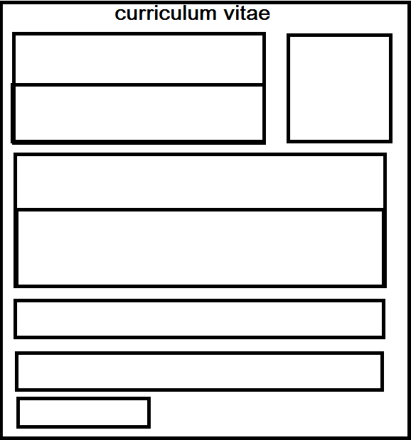
Structure of Curriculum Vitae
Notes:
Show Structure which is in folder PRIY

Slide 8

Tips for Curriculum Vitae
Get the basics right
Presentation is key
Stick to no more than two pages of A4
Understand the job description

Slide 9
Before You Begin
What is your Motivation to write this CV ?
Who will be reading it ?
Read CV of others…

Slide 10
Awesome Words To Use On Your CV
Evaluated: To determine worth or quality.
Formed : To create and developed in particular fashion.
Improved : To increase in value, quality and overall excellence.
Obtained : To come into position through effort or request.
Zipped : To act or move with speed and energy.

Slide 11

CV and Resume
Example :
CV and Resume of Mr.Shikhar Sharma
Notes:
Open CV PDF’s =>> then First Resume =>> then CV 1. LENGTH 2.CONTEXT 3. TIME

Slide 12

Tools for CV
LateX
Online tools
Notes:
Open CV PDF’s =>>

Slide 13

Common Mistakes
Change the cover letter and send the same CV to each company.
Show you are overqualified
Explain gaps
Avoidance of proof
Don’t lie

Slide 14
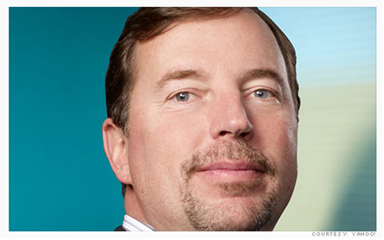
Effect of Mistakes

Slide 15
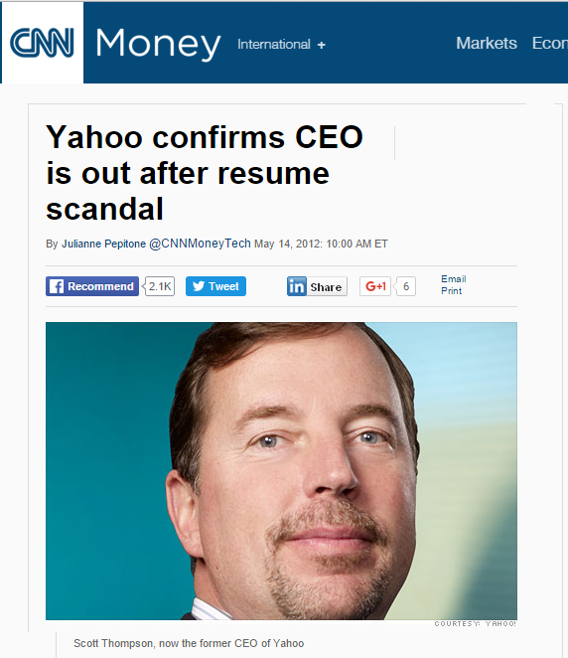
Effect of Mistakes
Scott Thompson’s
incident

Slide 16
Thank You !
Under Guidance of,
Prof. Dr. Churchill P. Samson
Komal Karande 1303014
Kartik Patil 1303036
Akshay Kale 1303043
Harshad Shinde 1303049
Yadnyawalkya Tale 1303052
Sai Kore 1303063
Presented by,

